Slide 1


Skin cancer detection
By Saif Malkshahi
Junior Data Scientist at BeCode

Slide 2

Contents :
What is cancer
Understanding the problem
technical aspects
Improve the Accuracy

Slide 3
What is cancer :
Definition of cancer.
1

Slide 4
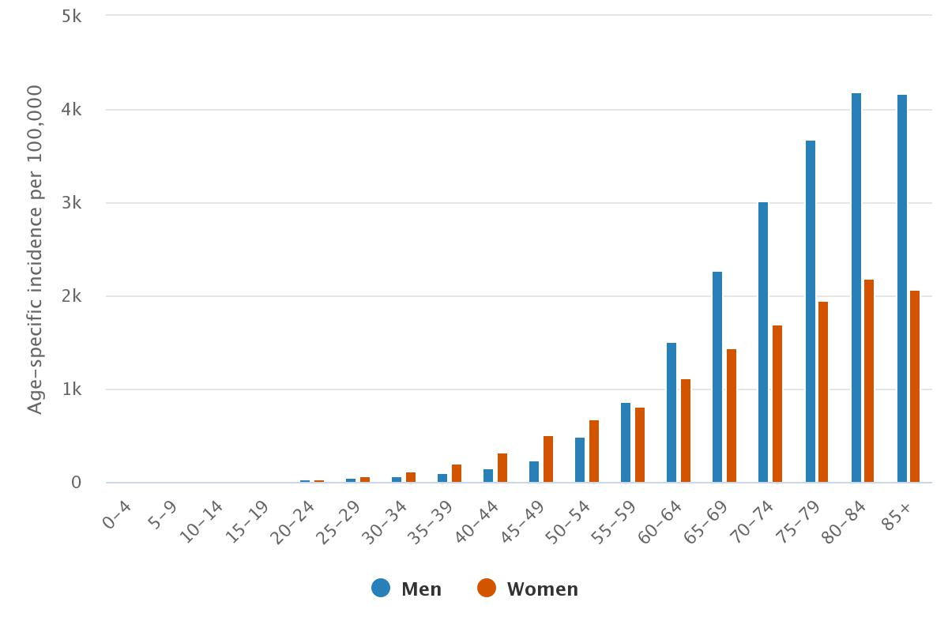

Slide 5
Understanding the problem:
1. Skin cancer is more easily prevented than other types of cancers as it appears on the outer side of the human body.
2. A trained eye can recognize moles and skin lesions that are cancerous.
3. Computer vision has the potential to assist visual detection and does not require to train an individual thus allowing for mass adoption.
2

Slide 6
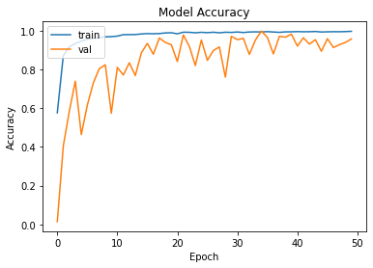
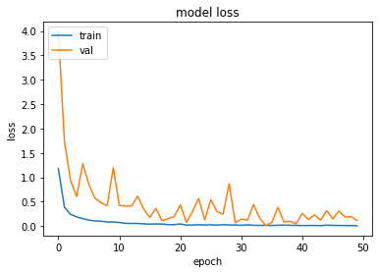
technical aspects:
- I build CNN model by using sequential model.
- A Sequential model is appropriate for a plain stack of layers where each layer has exactly one input tensor and one output tensor.
Model accuracy :( 0.7214 )
Model loss : ( 1.8070 )
3

Slide 7
Improve the Accuracy:
Get More Data
Add More Layers
Change Your Image Size
Increase Epochs
Decrease Color Channels
4

Slide 8
Thank you for your attention!
Questions
Comments
Feedback
Connect me on:
https://www.linkedin.com/in/saif-malkshahi
saifalbaghdadi6@gmail.com

